Slide 1

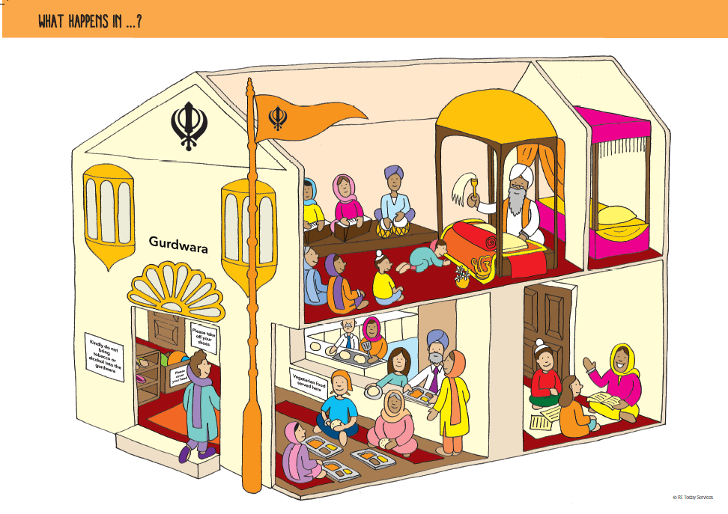
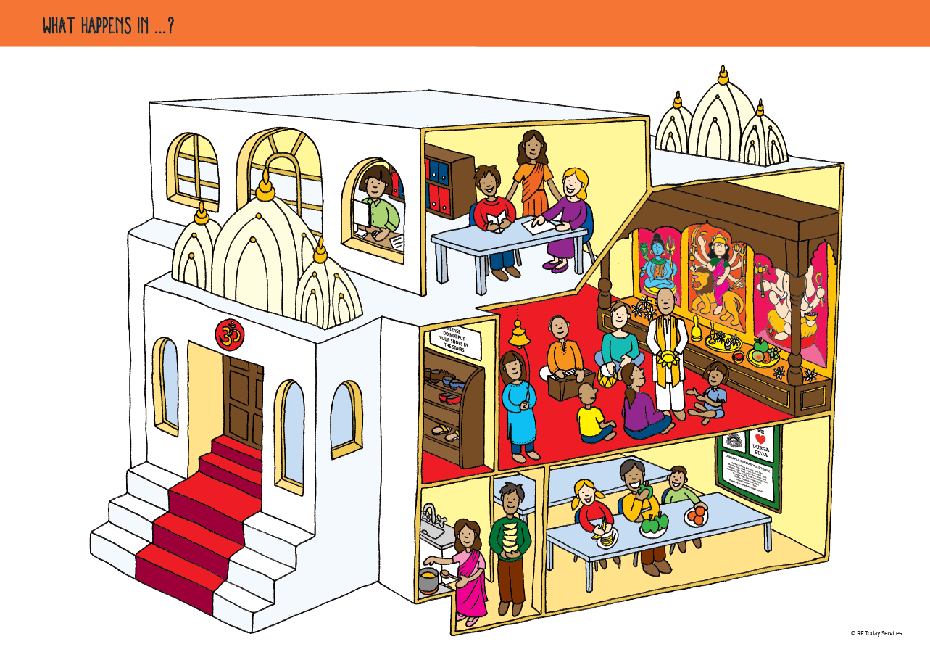
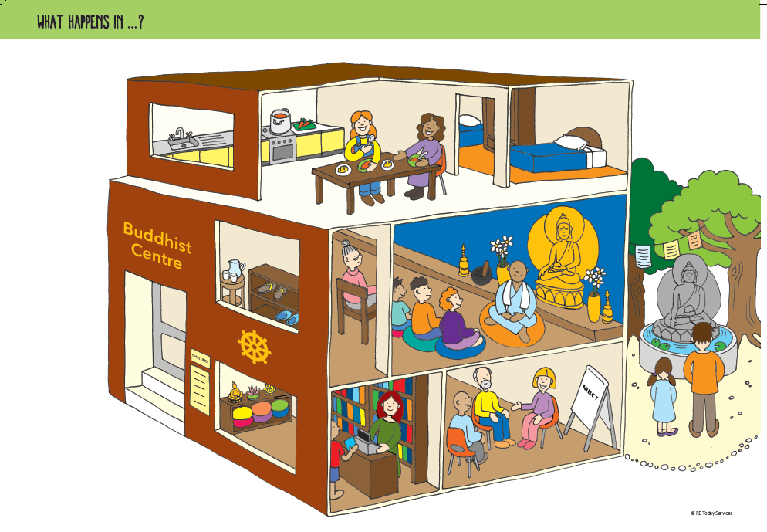
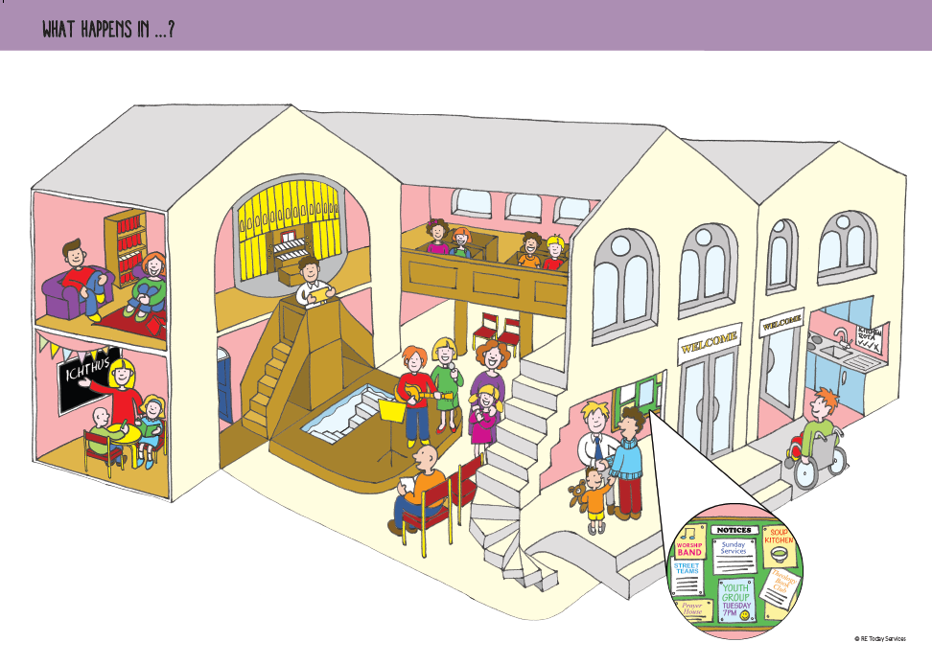
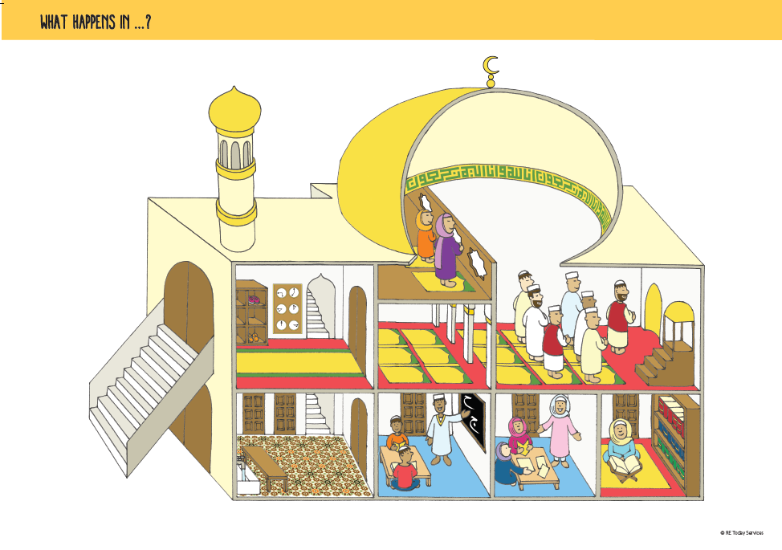
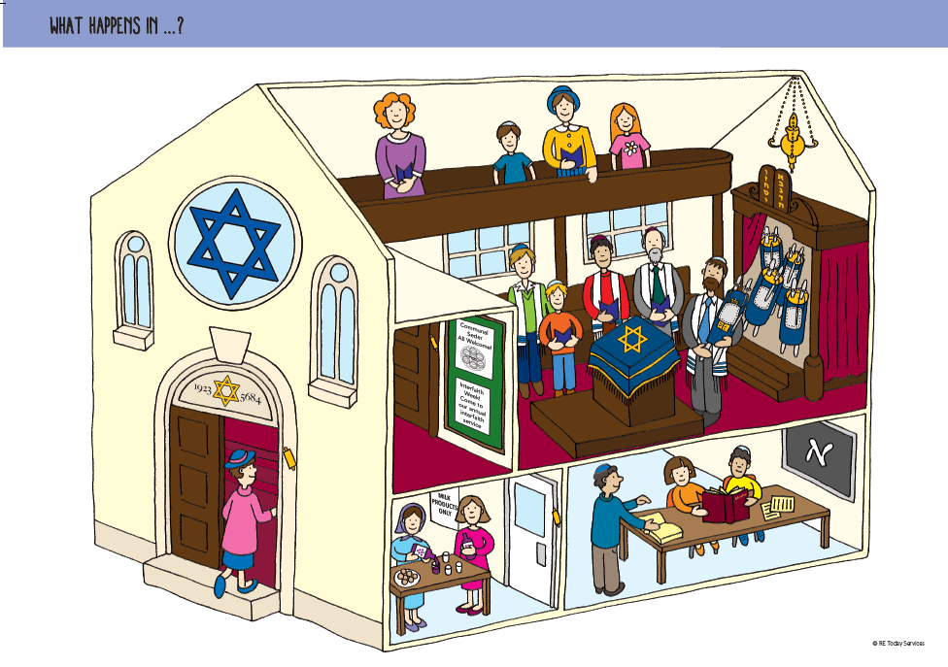
What Happens In?
Ian Nicholson
National RE Adviser Team Leader

Slide 2


Slide 3
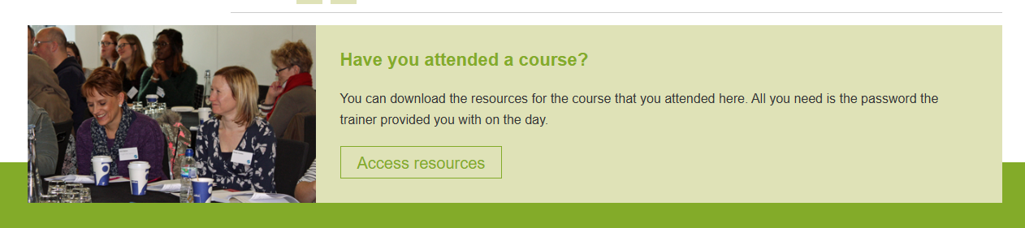
Downloads from today …
https://www.retoday.org.uk/school-support/resources/
Password: WhatH090326

Slide 4

Course Aims
To explore how What Happens In? can deepen learning about the matters of central importance
To develop disciplinary ways of knowing to use What Happens In? in the classroom
Be confident
Be generous
Be involved
Notes:
Share three values for our training:
Be confident: we ask you to be brave and share your thinking, your ideas and speak up. We appreciate that it can be scary sharing your thoughts and practice but by participating bravely in the network, you’ll get so much more out of it.
Be generous: if we have a generous, positive culture in the network, then everyone will learn and gain so much more from the sessions. So please do share your thoughts, engage in discussions and share your practice generously. There is no judgment on what is said but we want to hold a space for as much sharing and learning as possible.
Be involved : for us to achieve all of these things, we need you all to be present. We so appreciate that you’ve turned up at the end of a busy day and that lots of things are still happening in school around you. But we all know the importance of CPD and the impact it can have on your own practice and ultimately the outcomes for you pupils. You’ve prioritised your own CPD which is amazing, so to now make the most of your training, we ask for cameras to be on and for your full attention and participation. There will be breakout rooms and we cannot wait to hear what you’ve shared, discussed and created in them.
Great, with that said and those values in mind, let’s get started….

Slide 5

How far are these embedded in your own setting?
Substantive knowledge
Disciplinary Knowledge
Personal Knowledge
Effective transition from Key Stage 2 to Key Stage 3
A clear understanding of what we are assessing in RE
Formative assessment
Summative assessment

Slide 6

What are Matters of Central Importance?
that pupils will develop knowledge and understanding of the matters of central importance for the religious and non-religious worldviews studied.

Slide 7
National Content Standard for RE
Collectively enough substantive content and concepts in the RE curriculum to enable pupils to grasp the complexity of a multi-religious, multi-secular world. This substantive knowledge is a representation and reconstruction of religious and non-religious traditions and concepts.

Slide 8
National Content Standard for RE
Representations of religious and non-religious traditions that are as accurate as possible. Leaders and teachers might use scholarship to construct representations so that pupils do not learn misconceptions.

Slide 9
National Content Standard for RE
• Depth of study in certain areas of the RE curriculum to provide pupils with detailed content that is connected with the concepts and ideas that they learn. Without this, more complex discussions about religion and non-religion will be superficial. Leaders and teachers can make intelligent selections for depth of study to indicate a range of religious and nonreligious ways of living

Slide 10
National Content Standard for RE
A well-sequenced RE curriculum that prepares pupils with the prior knowledge (including content, concepts and vocabulary) they need for subsequent topics. The importance of this is very clear in the case of controversial and sensitive topics. Leaders and teachers might identify the necessary background knowledge that pupils need to learn for a topic and make sure that the curriculum is ordered to accommodate this.

Slide 11
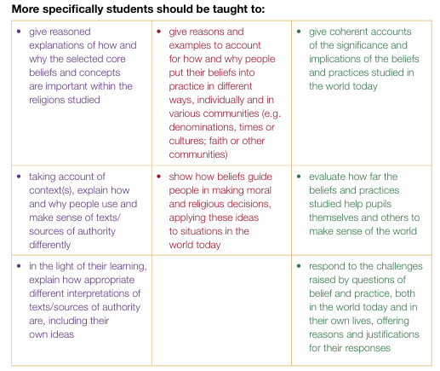

Slide 12




Slide 13
What are the matters of central importance in Hindu Dharma?
I will give you a clue – I have 8!

Slide 14
Substantive knowledge
Ahimsa
Ashrama
Atman
Brahman
Dharma
Karma
Moksha
Samsara

Slide 15
What about the other religions?
Buddhism | Christianity | Islam | Judaism | Sikhi
Buddha Dhamma Sangha | God Creation The Fall Incarnation Gospel Salvation Kingdom of God | Tawhid Akhlaq Ibadah Iman | God The Land and The People The Torah | God The Guru The Panth

Slide 16

Deep and Meaningful 2024
KS3 assessment was mainly concerned with knowledge that had been taught recently and did not draw on prior learning
In about a third of schools pupil knowledge was insecure and the prevalence of low stakes testing did not help them remember what they had been taught

Slide 17




Deep and Meaningful 2024
KS3 assessment was mainly concerned with knowledge that had been taught recently and did not draw on prior learning
In about a third of schools pupil knowledge was insecure and the prevalence of low stakes testing did not help them remember what they had been taught

Slide 18
So when students transition from Year 6 to Year 7 what do we need to know?

Slide 19
Atman (at least 19 examples)

Slide 20
Substantive knowledge
Ahimsa
Ashrama
Atman
Brahman
Dharma
Karma
Moksha
Samsara

Slide 21

What do the three mountains represent?
Why are the people only eating vegetables and fruits?
How is the priest showing his ashrama and his dharma?
What is offered at puja and why?

Slide 22
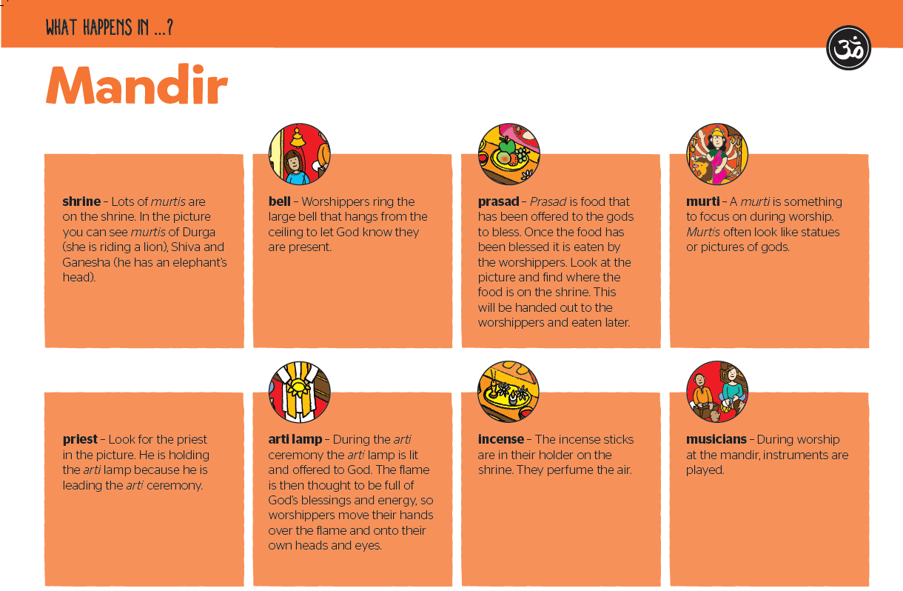
Are these also matters of importance?

Slide 23
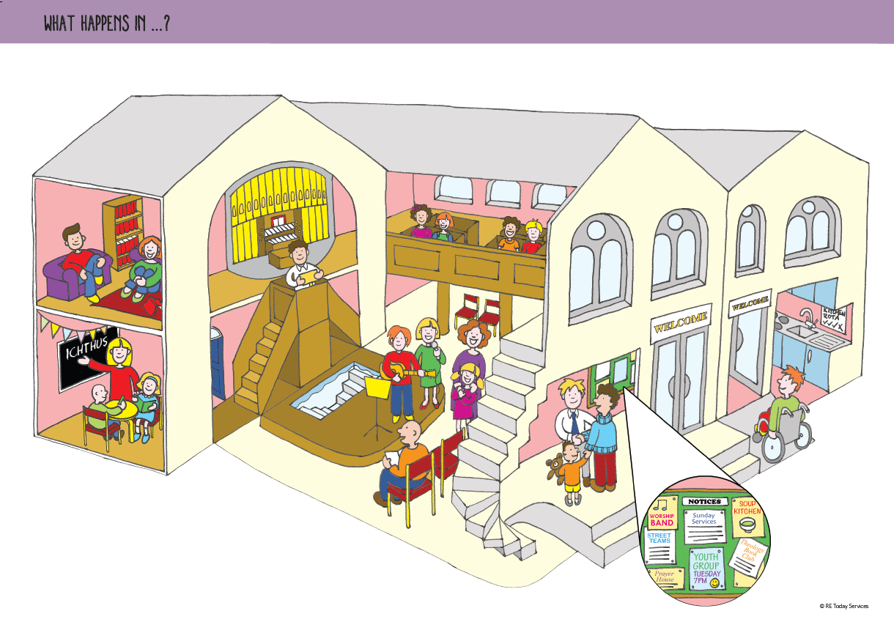
Gospel
Incarnation, God, Salvation
The Kingdom of God
Salvation, The Fall
Kingdom of God

Slide 24
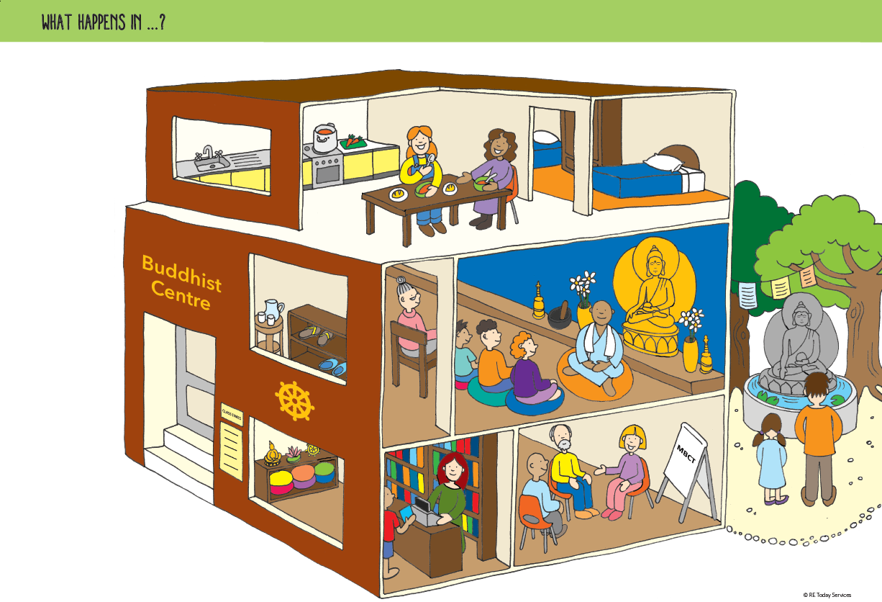
Formative or Summative or Both?
Explain what Buddhists mean by Buddha, Dhamma and Sangha

Slide 25

How can we move this activity on?

Slide 26
Can you think of any other uses for What Happens In?

Slide 27
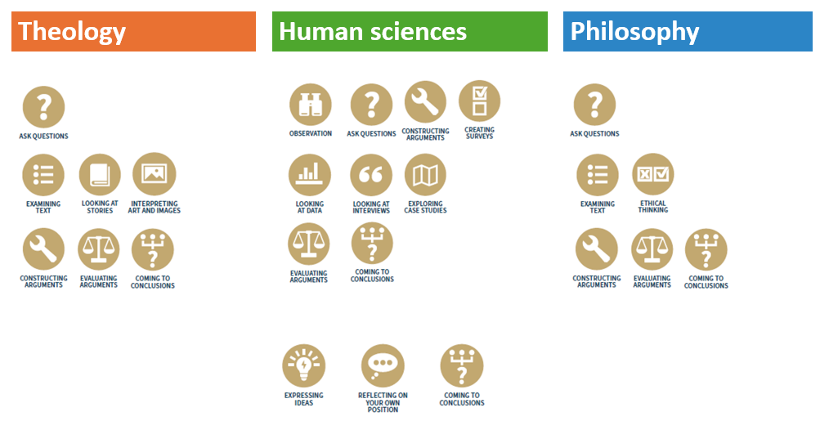
Which tools and methods have you used today?

Slide 28

Don’t forget to download

Slide 29
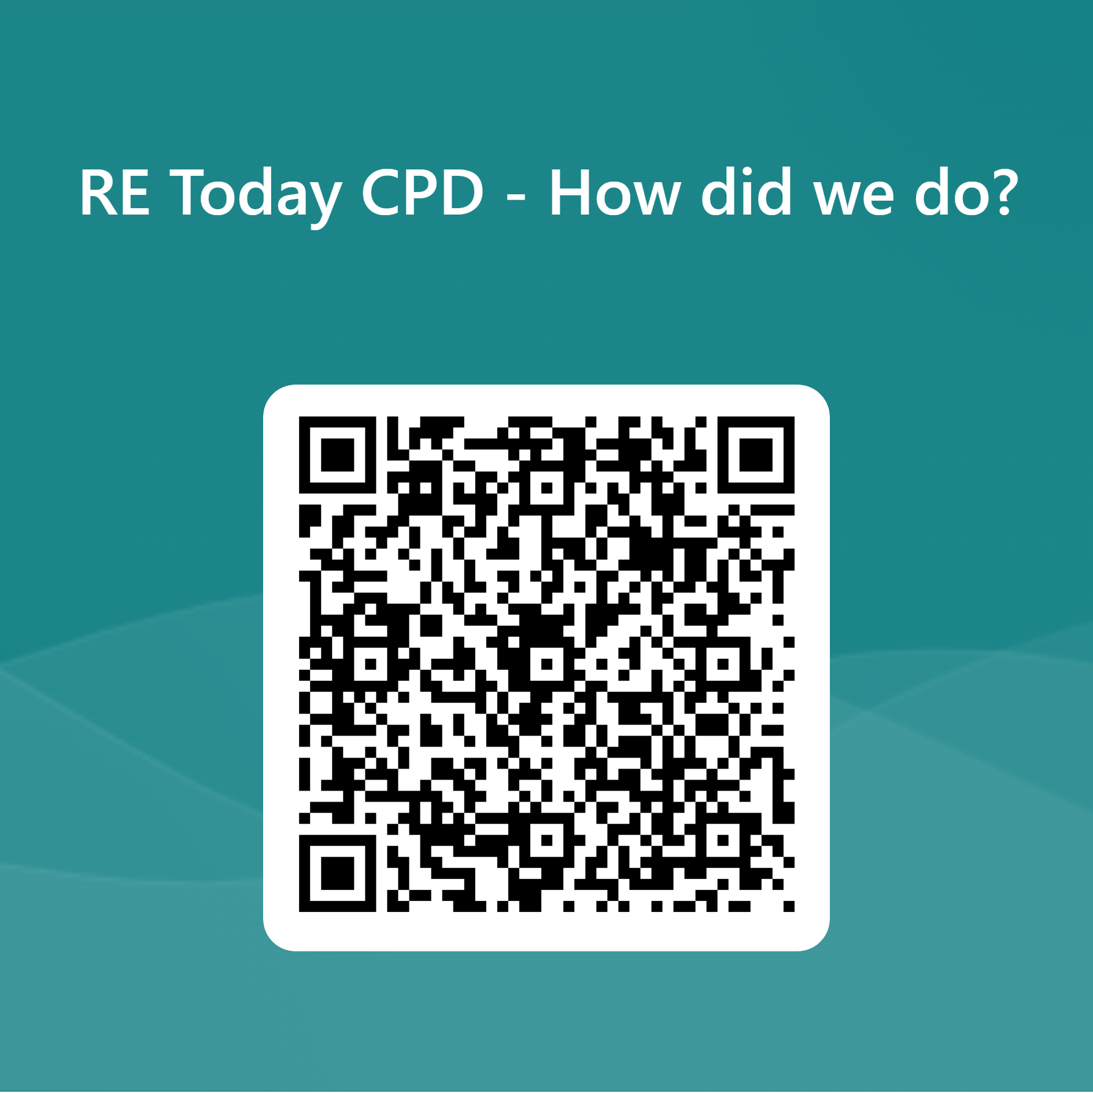
Your feedback is essential in shaping our courses to ensure they meet your expectations and requirements.
By sharing your feedback, you help teachers select the most effective and high-quality courses for teaching Religious Education.

